Slide 1

COLLEGE PROJECT · JAVA APPLICATION
Hotel Booking &
Occupancy Manager
A structured way to turn booking inputs into a clear stay summary.
Bharadwaj – 2620080095 · Mukesh – 2620090110
1
Notes:
Introduce the project as a Java application for organizing hotel bookings and occupancy-related decisions. Identify the team members and invite the audience to follow the application from input to summary.

Slide 2





APPLICATION PURPOSE
A Java application that turns booking inputs into a clear stay summary
Capture the booking
Calculate the stay
Accepts customer name, room type, number of rooms, and number of days.
Calculates total room charge from price × rooms × days.
Assign membership
Support staff decisions
Assigns Basic, Silver, Gold, or Platinum membership from the booking amount.
Reduces manual effort, improves consistency, validates inputs, and gives staff a quick booking summary.
2
Notes:
Explain that the application begins with a small set of booking inputs, then performs the calculations and classification needed by hotel staff. The outcome is a consistent summary rather than a manual calculation.

Slide 3
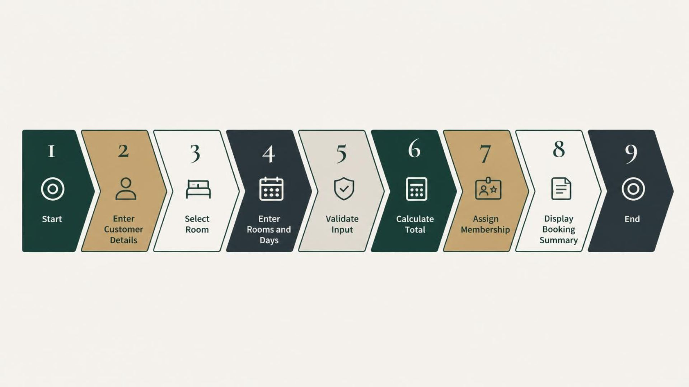
DECISION FLOW
The problem is a chain of decisions, not just a room-price calculation
Each stage prepares the next one. Validation must happen before calculation.
The application converts a booking brief into executable logic, checks the inputs, then produces a useful stay summary.
3
Notes:
Walk across the flow from start to end. Emphasize that the application is a chain of decisions: details are entered, a room is selected, values are validated, the total is calculated, membership is assigned, and the final summary is displayed.

Slide 4
CO1 · JAVA FOUNDATIONS
Java foundations turn a hotel brief into executable logic
CORE VARIABLES
Think first
Build the structure
String customerName;
int rooms, days, choice;
double price, total;
total = price * rooms * days;
Problem solving, computational thinking, algorithms, and flowcharts.
Java environment, program structure, programming model, identifiers, and literals.
Total Amount = Room Price × Number of Rooms × Number of Days
Work with values
Read from the console
Primitive data types, variables, constants, operators, expression evaluation, and type casting.
The Scanner class supports console input and output for a booking interaction.
4
Notes:
Connect each foundation to the hotel brief. The program needs named variables for booking details, operators for the total, and Scanner input so a user can provide the values at runtime.

Slide 5
CO2 · CONTROL FLOW
CO2: Control flow handles room choice, validation, and membership
ROOM SELECTION
MEMBERSHIP BANDS
switch (choice) { case 1: room = "Standard"; break; case 2: room = "Deluxe"; break; case 3: room = "Suite"; break; default: valid = false; }
Booking amount | Membership
Below ₹5,000 | Basic
₹5,000–₹9,999 | Silver
₹10,000–₹14,999 | Gold
₹15,000+ | Platinum
A loop can repeat this process for multiple room or booking entries.
Validation: if, if-else, nested-if, and if-else-if ladder.
Repetition: compound statements; while, do-while, and for loops; continue; infinite loops; nested loops.
5
Notes:
Show how switch selects one of the three room types and how default handles an invalid choice. Then explain that conditional ladders assign membership bands after validation and calculation. Loops make repeated booking entries possible.

Slide 6
CO3 · MODULAR PROGRAMMING
Methods and arrays make the manager modular and reusable
Methods & recursion
Arrays
Modular programming defines and invokes methods with parameters and return values. Overload calculateTotal() when booking inputs vary.
double calculateTotal(double price, int rooms, int days) { return price * rooms * days; }
Factorial shows recursion: a base case stops; a recursive case calls the method again.
int factorial(int n) { if (n == 0) return 1; return n * factorial(n - 1); }
One-dimensional arrays support traversal, searching, summation, average, and counting; enhanced for-each traverses each value:
int total = 0; for (int value : roomsByType) { total += value; }
TWO-DIMENSIONAL ARRAYS
A matrix represents room data by type and day; matrix arithmetic includes addition of matching booking matrices.
Room | Day 1 | Day 2 | Day 3
Standard | 2 | 1 | 3
Deluxe | 1 | 2 | 1
NEXT
6
Continued in Part 2 – CO4, CO5 and CO6.
Notes:
Close by showing how methods separate responsibilities and arrays organize repeated booking data. The same manager can grow through additional course outcomes in Part 2.

Slide 7
CO4 · CLASSES, OBJECTS AND EXCEPTIONS
Classes and objects bundle booking data and protect it with exceptions
Class & encapsulation
Exception handling
A class defines attributes and methods; an object is one booking. Private data members are read through getters and set through validated setters. Constructors set up each object: a default constructor and a parameterized constructor.
public class HotelBooking { private String customerName; private String roomType; private int numberOfRooms; private int numberOfDays; public HotelBooking(String customerName, String roomType, int numberOfRooms, int numberOfDays) { this.customerName = customerName; this.roomType = roomType; this.numberOfRooms = numberOfRooms; this.numberOfDays = numberOfDays; } public String getCustomerName() { return customerName; } }
try holds risky code, catch handles the error, finally always runs. throw raises an exception; throws declares it in the method signature.
class InvalidBookingException extends Exception { public InvalidBookingException(String message) { super(message); } }
if (numberOfRooms <= 0) { throw new InvalidBookingException("Rooms must be positive"); }
try { booking.validate(); } catch (InvalidBookingException e) { System.out.println(e.getMessage()); } finally { System.out.println("Check complete"); }
7
Notes:
Explain that the HotelBooking object keeps its data private. The InvalidBookingException is a custom exception that stops an impossible booking, such as zero rooms, before it is saved.

Slide 8
CO5 · STRINGS, FILES AND SEARCHING
Strings and files store customer names, room types and saved bookings
String handling
File reading & writing
Clean and compare user input before searching or saving.
String name = " Asha Rao ".trim().toLowerCase(); int size = name.length(); String[] parts = "Deluxe,2,3".split(",");
if (roomType.equals("Suite")) { System.out.println("Suite selected"); }
FileWriter saves a booking record; BufferedReader reads records line by line. try-with-resources closes both files automatically.
try (FileWriter fw = new FileWriter("bookings.txt", true); BufferedReader br = new BufferedReader(new FileReader("bookings.txt"))) { fw.write("Asha Rao,Deluxe,2,3\n"); String line = br.readLine(); }
Search: loop through records and keep lines where the name or room type matches the query.
8
Notes:
Show how trim, toLowerCase and equals make names comparable. try-with-resources closes the file streams even when an error occurs. Searching then filters saved booking records by customer name or room type.

Slide 9
CO6 · COLLECTIONS AND STREAMS
Collections and streams organise and analyse many booking objects
Storing bookings
Stream API
ArrayList keeps an ordered list of HotelBooking objects. HashMap links a customer name to that customer's booking amount.
List<HotelBooking> bookings = new ArrayList<>(); bookings.add(new HotelBooking("Asha Rao", "Deluxe", 2, 3));
Map<String, Double> amounts = new HashMap<>();
filter() keeps matching bookings, map() extracts values, mapToDouble() converts them, sum() totals them, and collect() gathers results.
double total = bookings.stream().filter(b -> b.getNumberOfDays() > 0).mapToDouble(b -> b.getAmount()).sum();
Example: Standard rooms at 4,000 per night, 2 rooms, 3 days = 24,000 total.
9
Notes:
Explain that an ArrayList stores many booking objects, a HashMap links each customer to an amount, and streams analyse the list in one readable statement. The sum shows the total booking amount.

Slide 10
CONCLUSION
Six Java outcomes build one structured hotel booking application
Course outcomes covered
Future scope
CO1 Java foundations: variables, data types, operators
CO2 Selection and iteration: room choice, validation, loops
CO3 Methods, recursion and arrays: modular logic
CO4 Classes, objects and exceptions: HotelBooking and validation
CO5 Strings, files and searching: records and lookup
CO6 Collections and streams: totals and analysis
Planned extensions only; not implemented in this project:
Database connectivity
Online reservations
Graphical user interface
Payment integration
Room availability tracking
10
Notes:
Summarise how each course outcome contributes to the manager. Stress that the future scope items are proposals and are not part of the current implementation.

Slide 11
SCREEN SHOTS
Program screenshots
PLACEHOLDER 1
PLACEHOLDER 2
PLACEHOLDER 3
Java program execution
Customer details input
Room selection
[Insert screenshot]
[Insert screenshot]
[Insert screenshot]
PLACEHOLDER 4
PLACEHOLDER 5
PLACEHOLDER 6
Booking amount calculation
Membership classification
Final output
[Insert screenshot]
[Insert screenshot]
[Insert screenshot]
11

Slide 12
PROJECT TEAM
Geo Tag Photo and GitHub Repository
Geo Tag Photo
GitHub Repository
[Insert geo-tagged team photograph here]
https://github.com/Bharadwaj-08/Hotel-Booking-Occupancy-Manager
Project Team Photo
THANK YOU
Thank you for reviewing the Hotel Booking & Occupancy Manager.
12

